Slide 1
Getting Started with the Microsoft Graph API
Introduction to Microsoft Graph API

Slide 2

Introduction to Microsoft Graph API
Intro to the Microsoft Graph API
Getting Started
SDKs and Code Samples
Resources

Slide 3
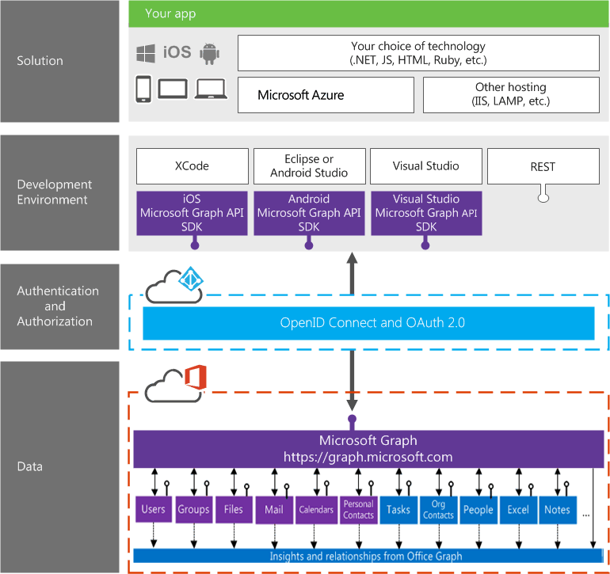
Building integration with Office 365
Notes:
Single resource that proxies multiple Microsoft services
Only one OAuth access token needed
Navigate across workloads and relationships logically

Slide 4








/groups
Shared with me
Shared with me
createdBy
createdBy
CONVERSATIONS
public
public
manager
directReports
directReports
directReports
directReports
EVENTS
EVENTS
modifiedBy
modifiedBy
FILES
FILES
memberOf
memberOf
GROUPS
GROUPS
createdBy
MESSAGES
FILES

Slide 5

Microsoft Graph Data
Users
tasks
photo
drive
Groups
photo
conversations
plans
SharePoint
Sites
Lists
ListItems
OneDrive
DriveItems
upload
download
copy
versions
Outlook Mail
messages
folders
send message
Outlook Calendar
events
find times
Azure AD
Contacts
Excel
Extensions
OneNote
People
Planner
Webhooks
Beta
Insights
Intune
Project Rome
Reports
Tasks
Teams
Notes:
Contacts (from Outlook contacts)
People (from Outlook people API – across mails, contacts and social)
Tasks (from Outlook tasks)
Extensions (schema extensions for typed/untyped data storage)
Intune (device management)
Project Rome (cross device/platform experiences around tasks)
Reports (Office 365 usage reports)

Slide 6

Microsoft Graph Capabilities
Auth
Credentials
Work/School
Personal
OAuth scopes
User
App
OData
Filter
Pagination
Metadata
SDKs
.NET
JS
PHP
Android
iOS
Query patterns
Web hooks
Delta
Extensions
Batching
Other
Swagger

Slide 7
Demo 01 – Docs https://graph.microsoft.com > documentation
Notes:
v1.0 documentation for users (entities, methods, properties, relationships)
Beta endpoint docs contain all v1.0 features (hard to see what is which)
Changelog
Known Issues
Authentication

Slide 8
Demo 02 – Graph Explorer https://graph.microsoft.com > graph explorer
Notes:
Metadata https://graph.microsoft.com/v1.0/$metadata
Me endpoint v1.0 vs. Beta
Show some sample queries
Login with bernd@DEV365x973253.onmicrosoft.com
Show some more sample queries

Slide 9
Demo 03 - Quick Start https://graph.microsoft.com > quick start
Notes:
Create UWP application
Login with bernd@DEV365x973253.onmicrosoft.com
Download sample
Unblock and extract
Compile and run

Slide 10

Resources
https://graph.microsoft.com/
Stack overflow – [Microsoft-Graph] and [Office-365]
Twitter – #MicrosoftGraph and #Office365dev
Issue list on Graph GitHub repo – https://github.com/microsoftgraph/microsoft-graph-docs/issues
Ignite Session BRK 3080 https://myignite.microsoft.com/sessions/54702

Slide 11

Summary
The Graph API is the combined API for working with Office 365 services.
Documentation, Graph Explorer, Quick Starts and SDKs help you get started with it.

Slide 12
Thank you

